Slide 1
Teaching Dossiers
Creating Your Own

Slide 2
What is a teaching dossier?
What are the exact expectations for a teaching dossier?
How do I refine/enhance my teaching dossier?

Slide 3
What Is a Teaching Dossier/Portfolio (US)?
What is it? A document of 5-20 pages
What does it do? Summarizes and documents your teaching accomplishments & strengths
Why do we bother? Used as part of a job search and in applications for merit, promotion, permanence, tenure, teaching awards, etc.
A teaching dossier is “to teaching what lists of publications, grants and honors are to research and scholarship...It presents thoughtfully chosen information on teaching activities along with indisputable evidence of their effectiveness” (Peter Seldin, 2004).
Dossier: Teaching :: Publications/Grants : Research

Slide 4
What Can a Dossier Show (What Are They Looking For)?
Evidence of commitment to teaching
Proof of teaching competency/excellence
Record of process and product of teaching: Course design, curriculum development, & teaching methods
Documentation of scholarship of teaching & learning (SoTL)
Demonstration of self-evaluation, reflective practice/critical reflection on teaching
Hard evidence of soft skills: Communication, facilitation, and leadership skills

Slide 5
Teaching
Dossier
Commitment
& Competence
Self-evaluation
“Soft” Skills
Scholarship (SoTL)
Product & Process

Slide 6
What Are the “Must Have” Components?
Depends on what required for what is being applied for – ALWAYS check (and ALWAYS meet/exceed the minimum requirements).
*Statement of teaching philosophy [elaborated in separate PPT]
*Teaching responsibilities (courses taught, your role, etc.)
*Evidence of teaching effectiveness (& teaching innovations; appendices)
[Biographical sketch]
Professional development activities
Educational leadership
Research on teaching (SoTL)

Slide 7
Biographical Sketch …
Not really a separate section (context/hook/set-up) – can include the following:
Past → Present → Future
Brief history of how you came to your current position
Your current overall responsibilities
Include the type of courses you currently teach
Courses you would like the opportunity to teach/develop

Slide 8
Biographical Sketch -- Example
“My teaching experience in higher education began when I was a Master’s student at Dalhousie University acting as a teaching assistant for Chemical Engineering Reactor Design. At Queen’s University, I had opportunity to teach and demonstrate in the Chemical Engineering laboratories for students in first, second and third years. I have also had the opportunity to teach introductory Chemistry and Chemical Engineering courses at Loyalist College in Belleville and at St. Lawrence College in Kingston. While my teaching experience is currently limited to undergraduate offerings I would welcome the opportunity to teach similar offerings at the graduate level.”

Slide 9
What Specific Kinds of Material Should Be Included?
Outline of Teaching Responsibilities
Courses taught & your role (2-7 years)
Course outlines (2 years; in appendix)
Students supervised in research (list; under/graduate)
Academic advising duties (list; optional)

Slide 10
What Specific Kinds of Material Should Be Included?
Evidence of Teaching Effectiveness
Summary of student evaluation marks (with scale & context indicated!)
Teaching awards or nominations
Letters from students, TAs, chair, supervisor, etc.
Peer evaluations of your teaching (Teaching Commons can help here!)
Objective indicators of amount learned
Quotes from student comments on your teaching (5-10 max)

Slide 11
What Specific Kinds of Material Should Be Included?
Evidence of Teaching Innovation
Original methods/materials (texts, creative handouts, web pages, assignments, [active-learning/authentic] assessments, [online] learning activities, software, simulations, etc.)
Contributions made to course development (new courses or substantial revisions)
Evidence of impact or effectiveness of these innovations

Slide 12
What Specific Kinds of Material Should Be Included?
Evidence of Professional/Teaching Development Activities
Teaching workshops (verifiably) attended
Training programs participated in
NOTE: For all these areas …
Save evidence along the way (hard copies, links, screen captures, etc.)
Do not include evaluation forms etc. – but have them available.

Slide 13
What Specific Kinds of Material Should Be Included?
Evidence of Educational Leadership
Membership on curriculum/educational policy/planning committees
Membership on teaching improvement/evaluation committees
Workshops you have run on educational development
Mentoring or peer consulting

Slide 14
What Specific Kinds of Material Should Be Included?
Evidence of Scholarship of Teaching & Learning (SoTL)
Papers, presentations, grants on/for teaching or curriculum issues
Published articles in SoTL journals
Conference SoTL papers/poster sessions etc.
Teaching-related publications

Slide 15
What Is a “Teaching Philosophy”?
A 1-2 page long statement of why/how you teach as you do
“Succinct, clearly reasoned” statement (not too emotive)
Personal beliefs about teaching and/or learning
How these influence your teaching methods & choices
NOTE: There is a separate PPT covering Teaching Philosophy Statements in depth. Please check it out!

Slide 16
What Should Be Included in a Teaching Philosophy?
Definition of teaching, definition of learning
View of learner and student development
Explication of student/teacher relationship
Teaching methods
Impact on learner
Innovative teaching approaches

Slide 17
What Should Your Teaching Philosophy Address?
How students typically learn in the discipline
Typical learning objectives in your classroom
How you achieve these learning goals
How you approach teaching
How you engage and motivate students
What types of knowledge/skills students learn in your class -- and how

Slide 18
A Brief Learning Theory Digression …

Slide 19
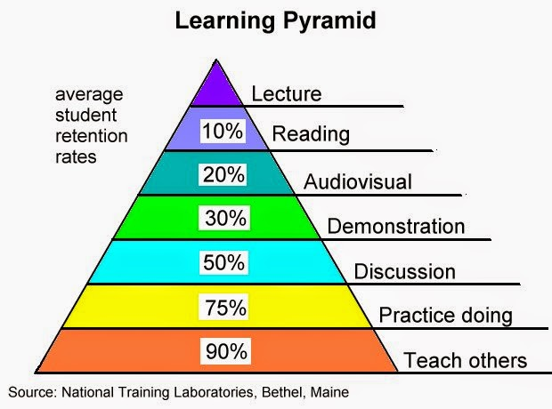

Slide 21
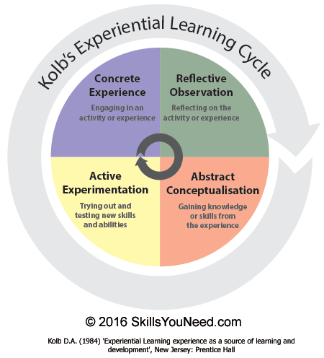
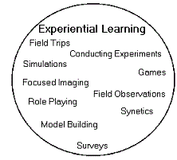

Slide 23
How to Create a Teaching Dossier (CAUT, summary)
1. “Clarify teaching responsibilities.”
2. “Select criteria for effective teaching.”
3. “Order the criteria” – “in the order that best fits their intended use.”
4. “Compile supporting evidence.”
5. “Incorporate dossier into the curriculum vitae.”
6. “Add exemplary materials.” (optional)

Slide 24
Useful “Fill-In” Information-Gathering Models
“Preparing a Teaching Dossier” (pdf; McMaster; “workbook”) https://teachingcommons.lakeheadu.ca/sites/default/files/inline-files/Preparing%20a%20Teaching%20Dossier%20McMaster.pdf
“Preparing Your Teaching Dossier” (web page; Western; chart) http://www.uwo.ca/tsc/resources/selected_teaching_topics/teaching_dossiers/guide_to_constructing/preparing_teaching_dossier.html
“Preparing the Teaching Dossier” (pdf; U of Toronto; “workbook”) http://tatp.utoronto.ca/wp-content/uploads/sites/2/TATP-Guide-Preparing-the-Teaching-Dossier-Megan-Burnett.pdf

Slide 25
Next Steps
Teaching Commons can be of great help:
Dossier consultations
Online resources
Peer assessment (private and confidential)
Pedagogical/technical instruction
Teaching consultations (private and confidential)

