Slide 1



Student Code of Conduct- Academic Integrity
Slides for Faculty Members & Instructors to cover with their students

Slide 2



Slide 3
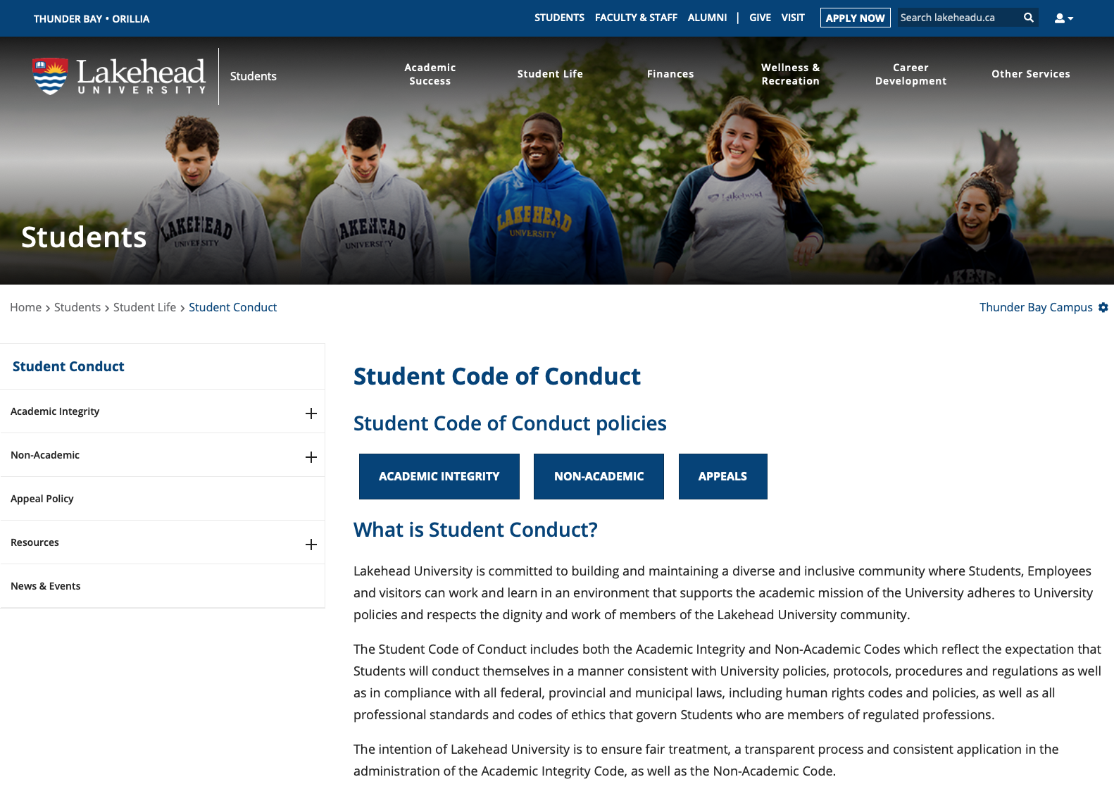
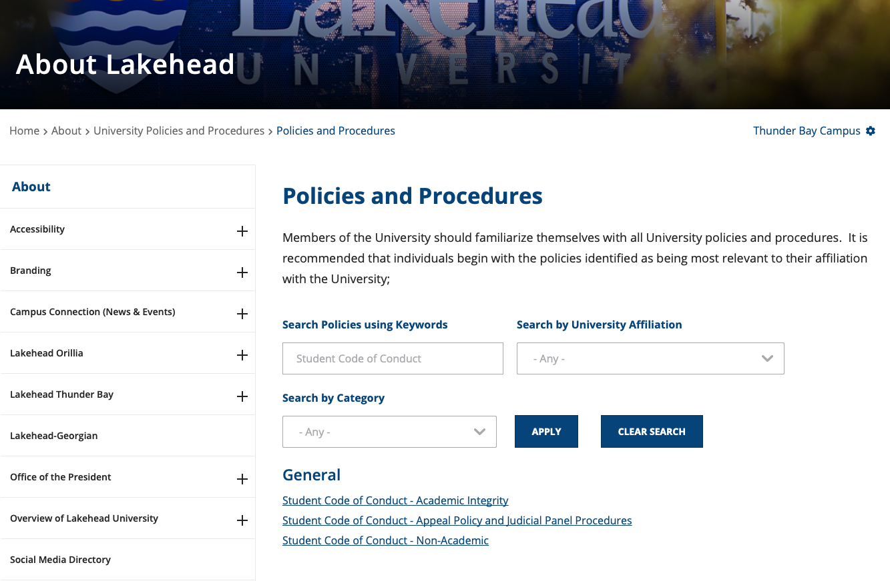
Where to find the Code
1. Student Life Page
2. Policies & Procedures Library

Slide 4
Course Syllabus Statement
“A breach of Academic Integrity is a serious offence. The principle of Academic Integrity, particularly of doing one’s own work, documenting properly (including use of quotation marks, appropriate paraphrasing and referencing/citation), collaborating appropriately, and avoiding misrepresentation, is a core principle in university study. Students should view the Student Code of Conduct- Academic Integrity - for a full description of academic offences, procedures when Academic Integrity breaches are suspected and sanctions for breaches of Academic Integrity”

Slide 5
3 Main Types of Academic Misconduct
Plagiarism
When a student does not give credit to the ideas, phrases, tables or illustrations of another person.
Via in-text referencing, footnoting, endnoting, quotations or indentations
If the student did not come up with the concept or idea themselves, it should be referenced.
Possession/Use of Unauthorized Materials
When a student accesses information for (or during) an examination that they were not allowed to access.
Writing answers on an object or yourself, accessing papers or electronic information during a test, copying answers from another student’s test
Accessing test or exam banks directed for instructors only or purchasing/selling tests or exams from/to other students.
Unauthorized Collaboration
When a student works with classmates on an assignment/exam that they were told to complete alone.

Slide 6




Helpful Academic Integrity Tools for Students
Academic Support Zone- through the LU Student Success Centre
ASK- Live chat with Ontario University librarian
OWL- Purdue Online Writing Lab
Zotero- Free tool for managing resources and citations

Slide 7
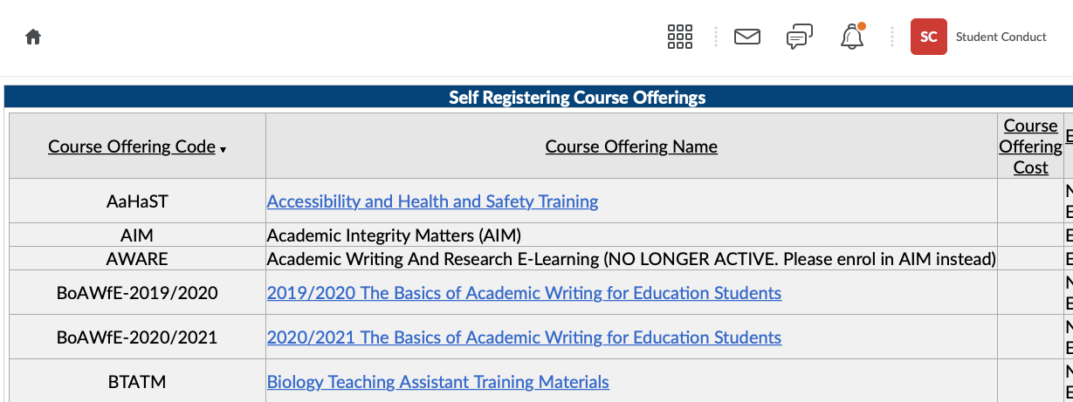
Academic Integrity Matters (AIM) Course- via myCourselink
*

