Slide 1
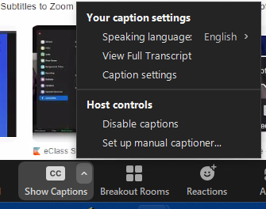
Instructions to turn on Transcriptions and Closed Captioning in ZOOM
As a participant in ZOOM you will see the button SHOW CAPTIONS
on the bottom of your screen, click it to turn captions on.
To turn TRANSCRIPTION on, click on the up arrow on the
SHOW CAPTIONS button, choose VIEW FULL TRANSCRIPT
If you click the up arrow you can also select Caption Settings, a pop-up window will bring you to the accessibility settings where you can change the size of the caption.

Slide 2
Instructions to Save a Transcript on ZOOM
There is a SAVE TRANSCRIPT button at the bottom of the transcript window on the right that will allow you to save this live transcript at any time.
Saving the transcript frequently is advised
After the initial file is created, all saves will be added to that file.
It is recommended before leaving the meeting to save it one last time.
The transcript is retroactive so it will save for the whole meeting from the time you joined it.

