Slide 1
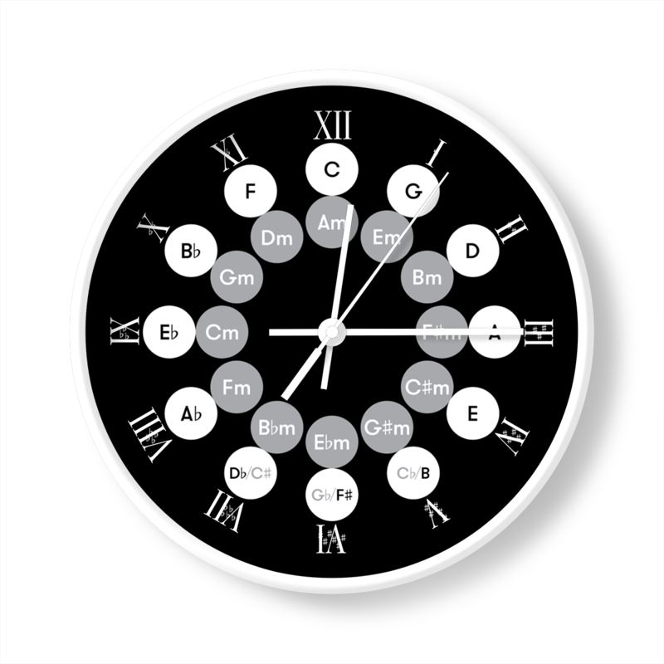
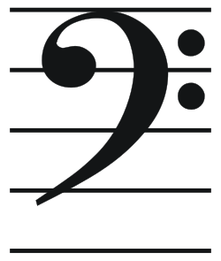

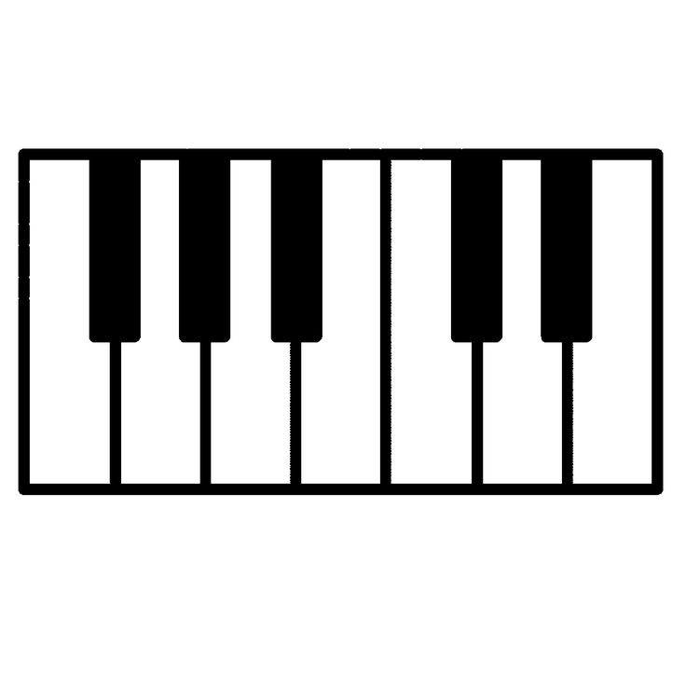
Music Theory Memory Aid
Student could draw a clock to represent the 12 tones. To remember the number of sharps and flats in a key, you move clockwise for sharps adding one all the way to seven. Move counterclockwise for flats. To remember the keys, you count the letters by fifths starting at C major at the twelve (no sharps or flats). C-G-D-A-E-B-F#-C#. Flats are the same but backwards C-F-Bb-Eb-Ab-Db-Gb-Cb.
To remember the relative minors, you jump to the 6th in the scale. Major to the 5th, relative minor will be the 6th note in the major scale. C, D, E, F, G, A, B, C. The sharps and flats are the same for a C major and an A minor. The differences between the major and relative minor are a matter of whole tones or half tones in the scale. To remember this a student could draw part of a piano keyboard. Black keys automatically are half tones and indicate sharps and flats, however white keys do not all indicate whole tones. Made up of whole tones and halftones and to remember this a student could draw a series of W and H. To remember the clef being used, Draw a treble clef and a G and a bass clef and an F.
WWHWWWH =M
WHWWHWW =m
=F
The Bass clef or the F clef is a stylized F and centered on the F note on the bass staff
=G
The treble clef or G clef is exactly that, a stylized G and the circle of the clef should line up with the G note on the treble staff.
F#/Gb G#/Ab A#/Bb C#/Db D#/Eb
F G A B C D E

