Slide 1
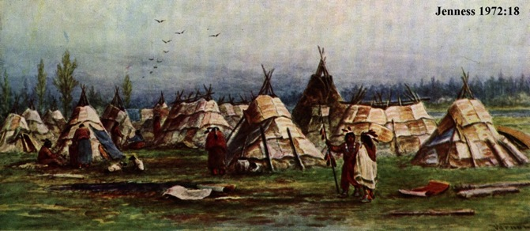
Ethnographic generalization about traditional Boreal Forest Foraging: the Eastern Subarctic.
generalized foraging (hunting, fishing, gathering)
highly mobile based on extended family social units, but broad social universe
fluid social organization, land tenure
comparatively simple and expedient technology suited to mobility
A warm season gathering of Subarctic foragers in birch bark covered shelters
Readings
Wright 1981 “Prehistory of the Canadian Shield”
Rogers 1983 “Cultural Adaptations: The Northern Ojibwa of the Boreal Forest 1670-1980”
Rogers 1988 “The Mistassini Cree”

Slide 2
Some enduring misconceptions about Subarctic & its people.
Unending ‘sameness’of the landscape (rocks, trees and muskeg)
Harsh, austere and constraining ecology (limited & diffuse food, risk starvation) (see Wright 1981)
Huge forbidding landscape: difficult access and transportation, challenging convoluted water transportation routes, dense/impenetrable forest.
Long cold winter and short warm summer (with a billion biting insects).
Ecological conditions ‘affect’ the nature of human culture.
Small, scattered groups preoccupied with basic survival in harsh environment.
Populations isolated (and insulated) from outside cultural innovations (from south).
Very conservative & unchanging economy, technology & social system. Emphasis on culture continuity through time and across space.
Constant risk of starvation and hardship.
A comparatively simple ‘culture history’, with not much more to learn (the ‘poor cousins’ of N. American Archaeology).

Slide 3
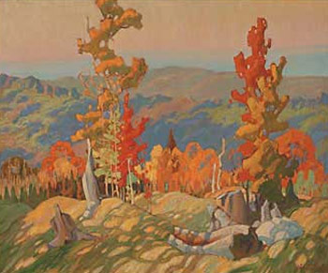
Where did these ideas come from?
European-origin people from the urban south writing about Boreal Forest Archaeology and Anthropology .
Popular images and myths about northern Canada (Group of Seven paintings, “Little Black Fly” song).
People usually experience the bush while travelling across it (railway or trans-Canada highway, 1960s hitchhikers stranded at Wawa).
Important archaeological literature written by influential ‘pioneers’: generalizations that became widely cited as given truths by future generations.
These generalizations have an element of truth, but also reflect ‘culture shock’, outsiders’ view, etc...
What is a Boreal Forest Aboriginal perspective?

Slide 4
The Precambrian Shield covers approximately one-half of Canada... physiographic variations do exist but on the whole the area is characterized by a basic sameness except where the dominating boreal forest fades into the northern tundra... The relatively close similarities of the archaeological assemblages throughout much of the region... is undoubtedly the most striking single characteristic of Shield prehistory. (Wright 1981:86)
J.V. Wright (1981) saw five factors contributing to cultural uniformity...
1) river and lake systems only effective means of communication and travel... also important for food (shoreline settlement orientation)
2) two major food sources (caribou, fish) with broad range of supplemental sources.
3) fires are endemic & large, forcing people to move frequently (a constraint or hazard)
4) small hunting groups... flexible marriage & residence patterns, wide social networks.
5) limitations of Boreal Forest ecology imposed limits on subsistence choices, social organization, and isolated inhabitants from outside developments...

Slide 5
Brain Fagan, in Ancient North America, describes Canadian Shield culture, specifically Shield Archaic. Reflect perspective about all human history in the region.
There they developed the distinctive Shield Archaic tradition, an adaptation to the country of lakes, rivers and boreal forest with but sparse game and vegetable resources. The people lived in small bands, mostly near lakes and rivers and close to regular caribou migration routes... The Shield Archaic was a profoundly conservative adaptation, one that changed but little over many millennia... For thousands of years in places right up until European times, Shield Archaic bands flourished in almost complete isolation from the more temperate world to the south... The sheer vastness and isolation of their harsh forested wilderness shut off most possibilities of cultural transmission from more sophisticated societies to the south... (Fagan 2005:401-402)
What intellectual ‘baggage & bias’ is reflected here?

Slide 6
Assumptions/Assertions of Cultural Continuity and perhaps also ethno-linguistic continuity over thousands of years.
...Perhaps we can understand ancient lifestyles by developing analogies based upon ethnographic observation of early to mid 20th Century Aboriginal culture thought to be ‘relatively unaffected’ by contemporary s. Canada. (Is this really valid?)
Socio-political organization and group size
Subsistence economy
Land use and tenure
technology
spirituality
While offering enduring utility, we have to be careful not to become slaves to ‘ethnographic analogy’
Subarctic culture is not static, nor a cultural ‘living fossil’

Slide 7
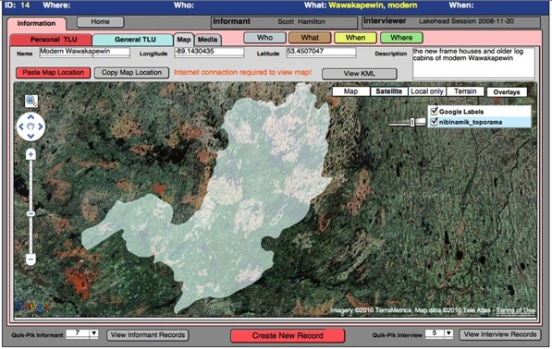
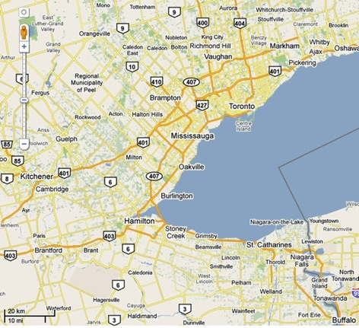
Foragers require large areas to sustainably harvest natural resources over generations.
20 km
Nibinamik FN traditional territory superimposed over the Greater Toronto Area mapped at the same scale.
Only one ‘small’ part of n. Ontario.
This is traditional homeland to perhaps 500 to 800 people. How many live in same area in southern Ontario?
20 km

Slide 8
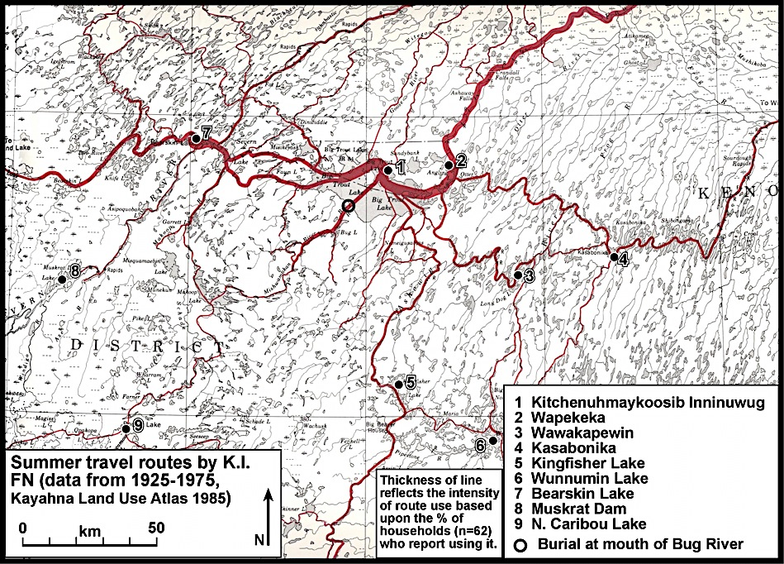
Also requires high mobility & efficient transportation
early 20th Century travel routes (summer vs. winter).

Slide 9
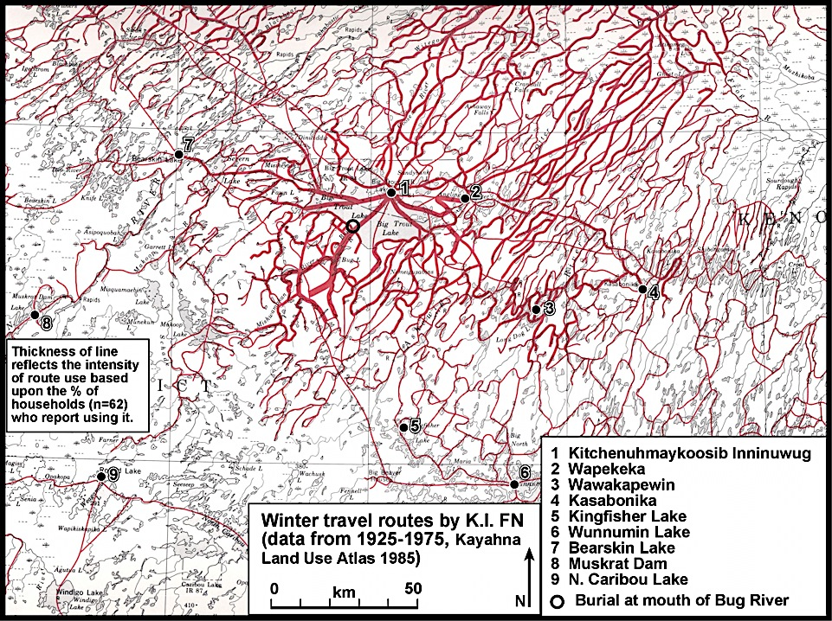

Slide 10
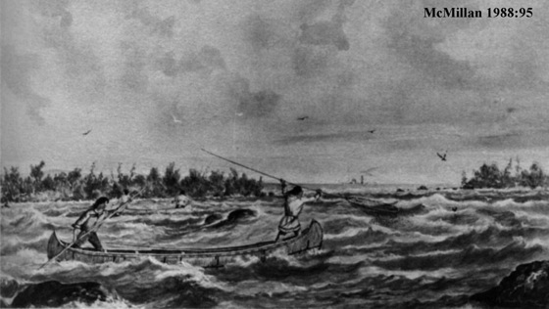
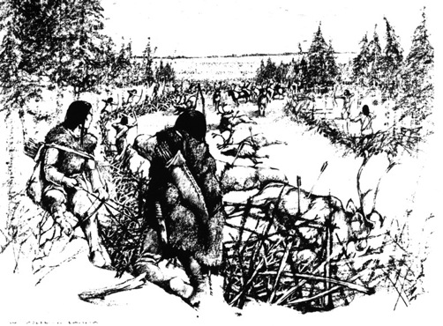
Food seasonally sparse, & often vulnerable to over-hunting.
Some seasonally clumped & predictable resources, (fish & sometimes caribou).
Macro-bands gather at strategic places when predictable & ample food resources are expected.
Larger workforce: construct caribou fences or fish weirs. Ensures efficient harvest & processing of food (surplus).
Gatherings important for strengthening inter-group bonds, planning, ritual activities, courtship, etc.
Top: Harpooning fish in rapids during a spawn.
Left: Caribou fences were used to trap animals for communal slaughter.

Slide 11
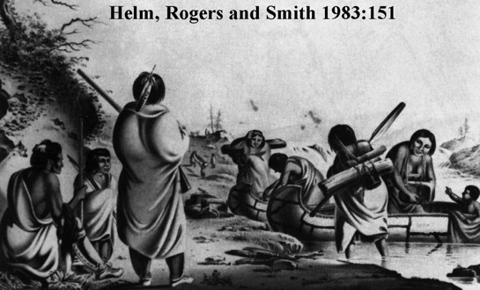
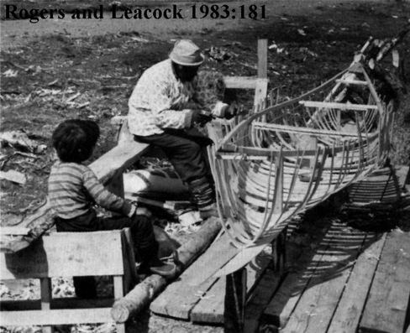
Warm-weather transportation in canoes: light-weight watercraft of birchbark over cedar frame.
Made from local materials, comparatively large cargo capacity, sufficiently lightweight to portage.
Canoes ideal for mobility required for broad-spectrum foraging.
With knowledge of the water transportation routes people moved over vast regions.
The economic requirement for mobility favoured a light-weight and expedient tool kit.

Slide 12
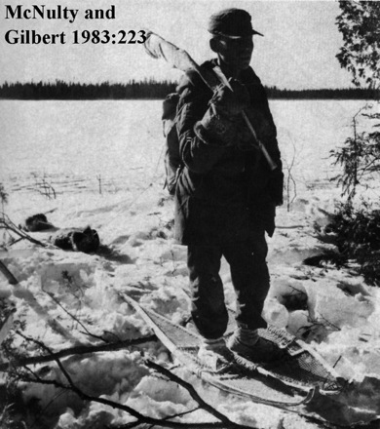
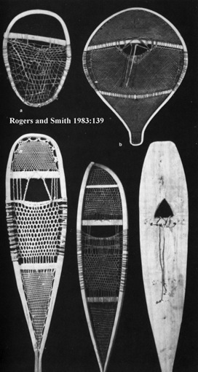
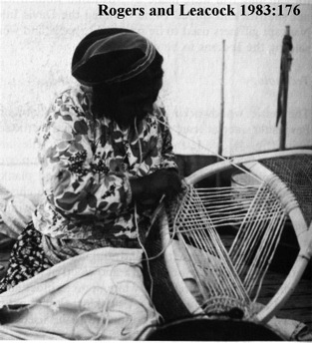
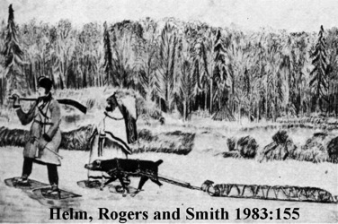
In winter the wetlands freeze, permitting travel virtually everywhere.
Travel over the snow was possible only with snow-shoes.
The wood frames were webbed with moose or caribou hide strips.
Dogs pulled sleds composed of long planks with curved front ends (tobaggans).

Slide 13
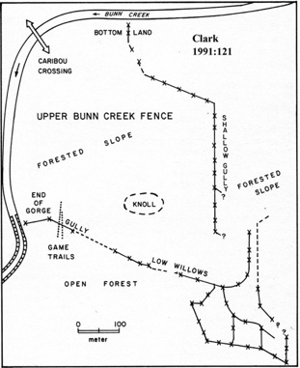
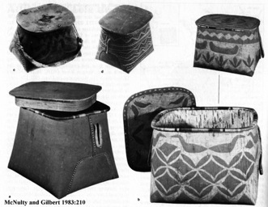
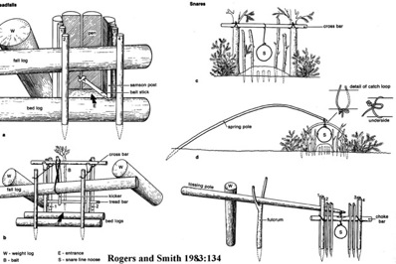
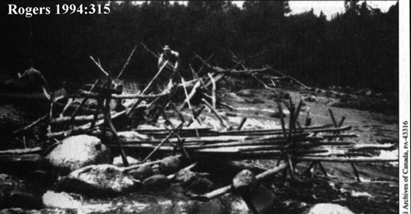
Technology enabling large-scale capture and killing of clumped prey.
Caribou fences to trap herds at predictable places (river crossings).
Wood or stone weirs designed to capture spawning fish.
In order to succeed needed workforce and coordination of labour.
lightweight and expedient storage with bark containers.
passive capture using snares and traps

Slide 14
Boreal Forest Seasonality.
Seasons condition food availability, and ability/means of travel.
migratory waterfowl?
fish spawns?
plant foods (shoots, roots, seeds, fruit)
moose rut
caribou migration
wild rice ripening
Can people move during freeze-up or break-up? How do they find food during those brief interludes of immobility?
Some resources are spatially concentrated (clumped) at certain times.
Do people have the technology and workforce to take advantage of that plenty? (fish at rapids, narrows, falls, straits, etc)... using natural features, or construct weirs, nets, harpooning stages...
With the need for many workers to build facilities and process the surplus, related families might gather during that time of plenty (planned annual events).

Slide 15
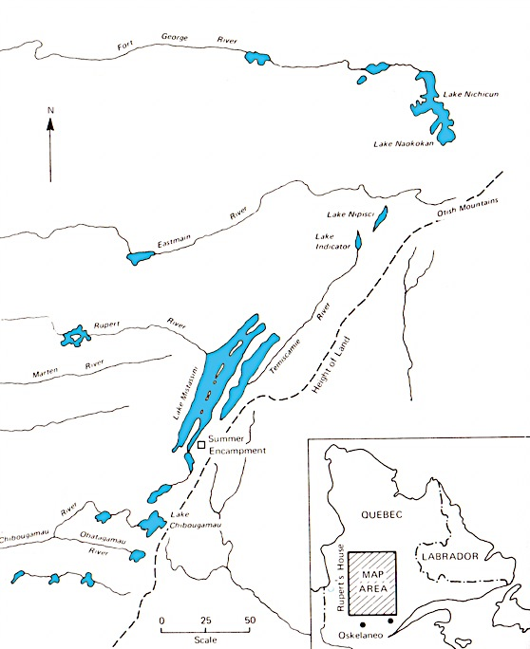
Ed Rogers worked extensively in n. Quebec and Ontario with Cree and Ojibwe people.
In early 1950s spent time in Misstassini L area, documenting the Cree foraging/trapping lifestyle.
See Rogers (1988) for a summary article re his research.
His work is widely used to build analogies re subarctic foraging.
Also by archaeologists in modeling pre-contact subarctic foraging.

Slide 16
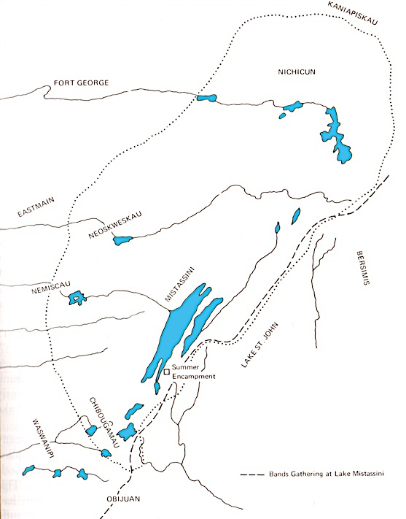
Yearly cycle: winter dispersal of individual extended families (10 to 20 people) throughout large hunting territory.
With warm season the family bands gather at central aggregation places.
Note winter territory used by families at one summer gathering place.
Summer gathering supported by predictable dense food supply (fish).
Winter dispersal to seek diffuse and mobile terrestrial game (moose, caribou, fur bearers).
Terrestrial resources are easily over-exploited so hunters need to be careful to harvest in ‘sustainable’ fashion (let harvested land rest).
Rogers 1988
50 miles

Slide 17
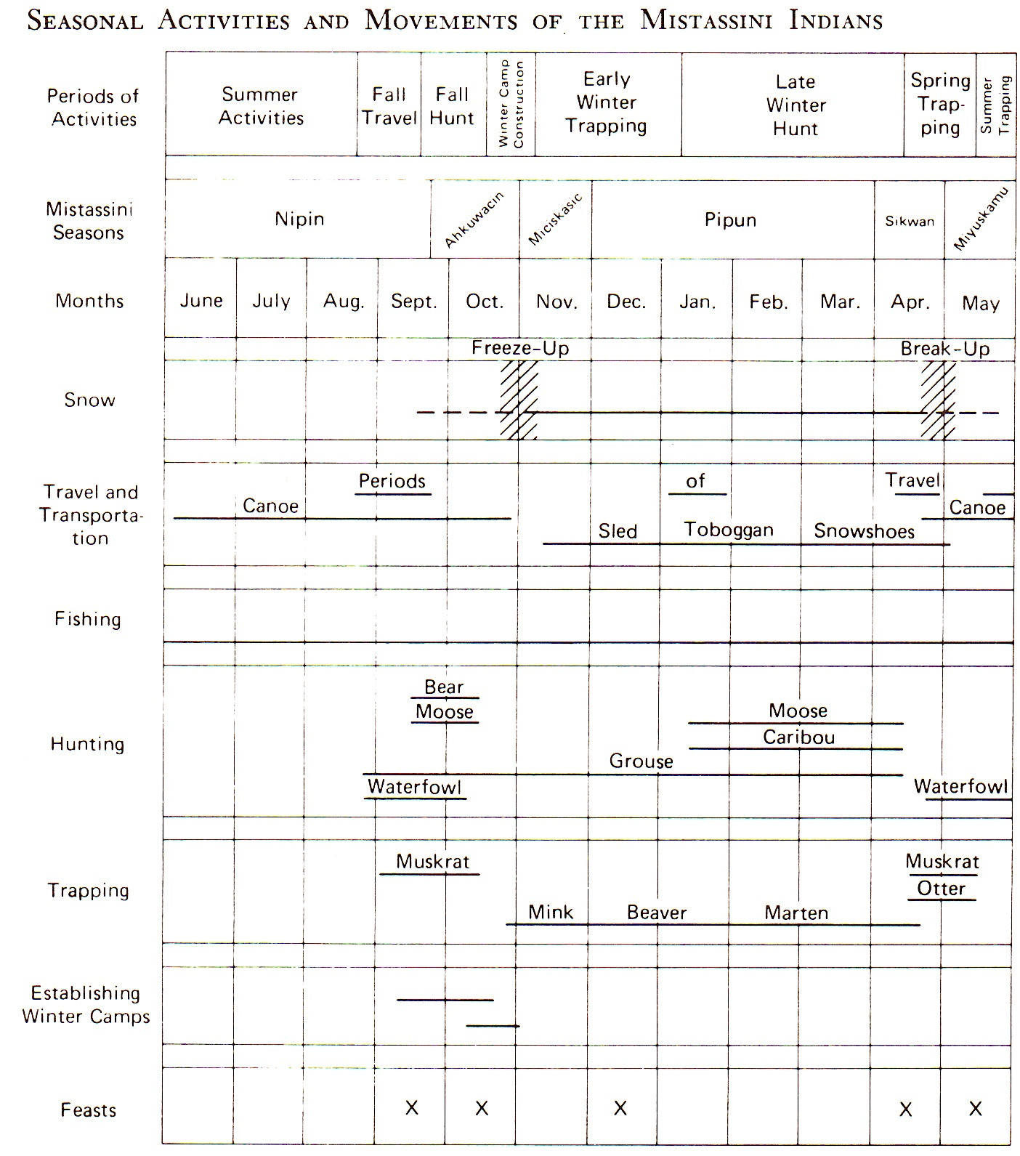
Rogers 1988
Rogers reports the 6 season Cree cycle, seasonal work activities, and economic shifts through the seasons.
Note the critical timing of Freeze-up and Break-up. Stores of food need to be built up at those times when mobility is minimal.
Fishing is important year-round, but particularly so to support the summer gatherings (reliable fishery on large lakes or spawning runs).
Also note fall and spring hunt of migratory waterfowl.

Slide 18
Misstassini Annual Cycle (Rogers 1988)
Fall Travel: end of summer (late Aug to mid Sept), families stock supplies & pack for canoe travel to winter trapping grounds (up to 300 miles away).
Fall Hunt: temporary tent camps, (late Sept to mid Oct), intensive hunting (moose, bear caribou) dried for winter use. Group mobile in pursuit of game.
Winter Camp Construction: near freeze-up more permanent camps established- some used all winter, others are shifted in Jan. log cabin base with prospector tent top, or pole/turf roof.
Early Winter Trapping: at freeze-up, season of intensive trapping begins as soon as soon as ground/lakes frozen. Men out on trap line for days at time, women run trap camp, check local snare lines and fish nets.
Late Winter Trapping: In early Jan, the hunt camp is regularly moved. food is scarce, and people have to move to a new more productive area- toughest time of year. This can continue until mid-April. groups gradually return to where canoes are cached in fall (good fishing place).
Spring Trapping: return to canoe cache, establish a longer-term camp. waterfowl and fish are taken people await breakup and by mid May are ready to travel to summer gathering places.
Spring Travel: with breakup (late May) groups quickly move to to summer gathering.
Summer Gathering: from June to Aug is a time of relaxation. repair equipment, plan for next year, feast and celebrations based on fisheries, by fall resume the cycle.

Slide 19
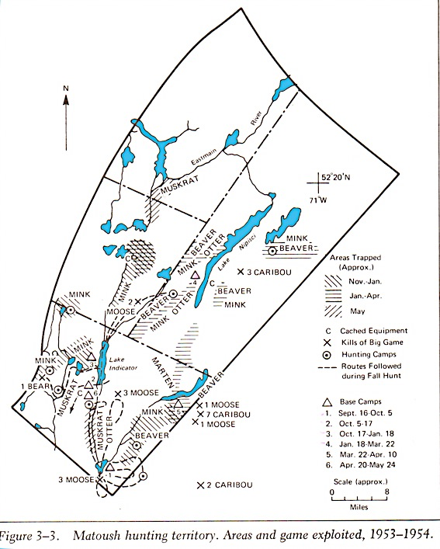
Women and children occupy winter base camps, run local snare lines & fish nets through ice, process hides & manage the camps.
Men make long foraging trips on snowshoes checking the traps or hunting.
When a local hinterland begins to become depleted, the group moves to a new fresh area (move people to resources rather than haul resources back to a central base).
This arduous lifestyle requires a combination of skills: technical, physical strength & endurance, information management and decision-making, and supernatural support...

Slide 20
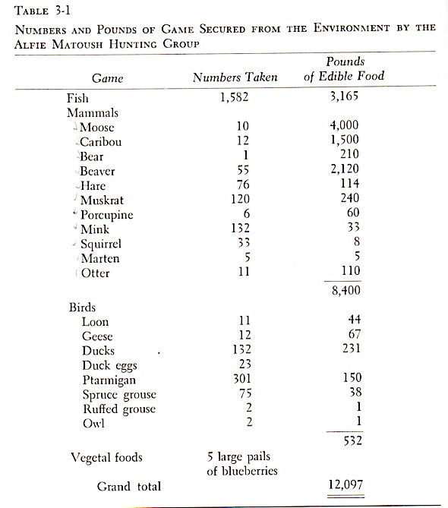
Rogers 1988
Harvest requirements of 1 hunting group in winter 1953-54.
Likely 10 to 15 people (adults and children).
Seems like a lot of food, but represents food intake for 6 to 8 months in cold climate with much hard labour.
Mammals contribute meat, fat, and hides/furs. Furs provide cash to buy supplies (tea, flour, salt, sugar, ammo, snare wire, clothing, textiles, utensils, etc).
This level of harvest will deplete foraging territory, requiring it to be allowed to ‘rest’ until ready for harvest again.
Land is cyclically harvested not unlike ‘farming’.

Slide 21
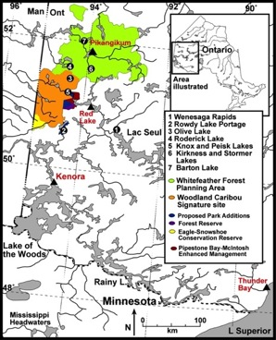
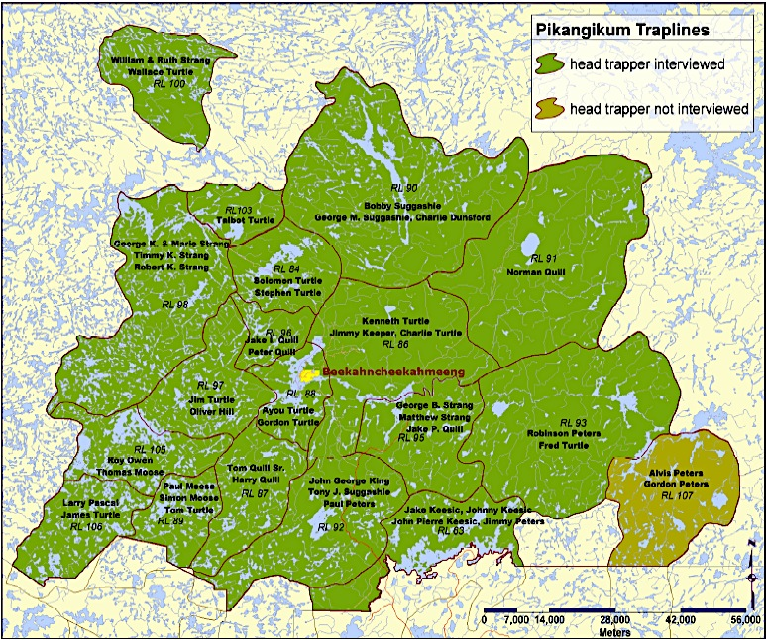
Trapping lands in Pikangikum FN Whitefeather Forest
trap lines
Each family needed large land tracts for sustained foraging.
Boreal Forest vulnerable to over-exploitation. Traditional foraging involves allowing land to ‘rest’ or recovery from foraging.

Slide 22
In 1930s Hallowell identified 32 winter hunting groups, each with an average size of 16 people (hunters to non-hunters 1:3) in upper Berens River area.
Each winter hunting territory averaged 93 square miles (but ranged from 13 to 212 square miles).
These 32 winter groups formed five discrete summer fishing settlements (aggregation locales).
Pikangikum Band: Poplar Narrows (60 people in two clusters), Barton Lake (50 people in one cluster) and Pikangikum Lake (122 people in five clusters).
Little Grand Rapids: Pauingassi, Little Grand Rapids

Slide 23
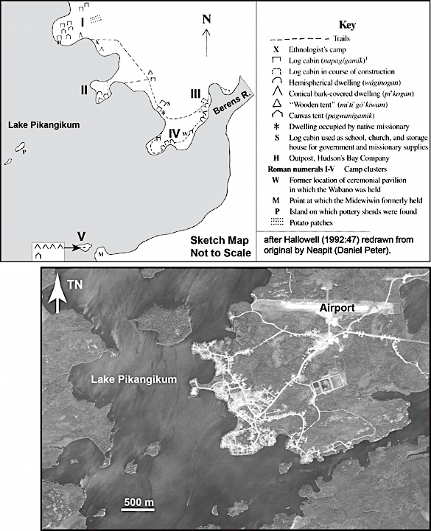
Pikangikum in mid-1930s. Few permanent houses. Five residence clusters (tents, traditional shelters).
Note location of traditional ceremonial structures.
Pikangikum now numbers over 2000 people crowded on the same reserve land.
Now people live permanently in frame houses, with a Northern Store, day school, hockey arena.
Serious social & health problems, high incidence of substance abuse, suicide, etc.
The current reality has developed over the past 60 years of transformation.

