Slide 1
Thumbnail sketch of subarctic ecology & ethnographically defined human adaptation.
Important environmental variables to consider
biotic diversity & density
resilience/recovery from stress, disturbance
vulnerability to change
resource accessibility & predictability
seasonal resource fluctuations
We will talk about arctic ecology and culture later...

Slide 2
The ethnographic literature, and the theoretical constructs used.
archival records by predominately European writers for commercial, religious, military, or colonial purposes (variable comprehension, bias & vested interest).
early to mid 20th Century ethnographers with diverse theoretical perspectives.
implications of ethnocentric views of the north (believing is seeing)
impact of various competing theoretical perspectives of emerging anthropology (19th C. cultural evolutionary notion of ‘progress’, early 20th C. inductive description, mid-20th C. cultural ecology, etc).
ethnographic observation of societies that had already been subjected to 200 to 400 years of colonial contact and socio-economic ‘integration’. (what is product of acculturation and what is indigenous?).
What implications for ‘contemporary norths’?

Slide 3
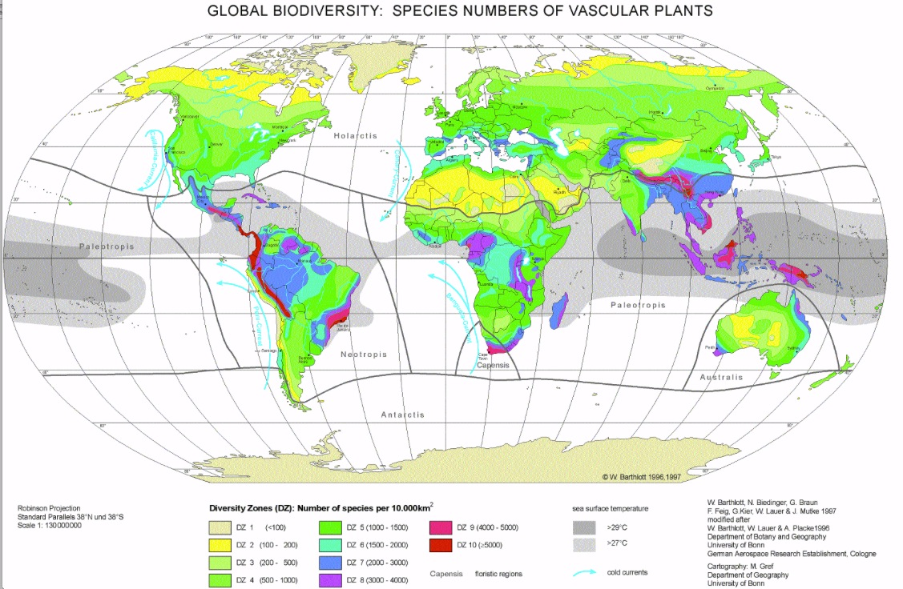
Biotic diversity and density declines sharply with Latitude.
Plant diversity map measures no. of species per 10,000 km².
Animal diversity map measures no. of terrestrial species per 100 km²
Animal Diversity
What about marine & aquatic biodiversity?
How might that affect terrestrial situation?
Plant Diversity

Slide 4
Ecological Dynamism in the Subarctic
Variability across geography
hydrology, precipitation, sediment, bedrock, micro-climate, slope/aspect
Variability across seasons
warm versus cold season... but are 4 seasons a cultural construct?
Cree traditionally use a 6 season system (Early Spring (early breakup), Spring, Summer, Fall/Autumn, Freeze-up, Winter.) Why are the two extra seasons important?
Short-term disturbance and succession
Fire, snow, wind and insect damage to forest
successional sequence
predator/prey cycles
Long-term climatic change
Pleistocene (ice age end, and Holocene response i.e. hydrological implications of isostatic uplift)
Holocene climatic shifts (Hypsithermal, Boreal, Neo boreal, Neo-Atlantic, etc).
With all this variability, how do we think about the environment as an independent variable affecting human culture?

Slide 5
Ecological Dynamism in the Boreal Forest
Forest Succession
Dynamic change in forest composition (over time) due to: climate, rate of soil weathering and development, nutrient and water availability, shade tolerance and forest disturbance.
Forest Disturbance
Frequency and severity of natural succession processes.
Forest Trophic Levels
Biomass, biotic diversity: accessible biomass varies with succession level.
Most diverse & accessible biomass is found at earlier stages of forest succession (low trophic levels). Least diverse and accessible biomass is found at late stage forest (high trophic level)...
Readings:
Winterhalder (1983a) “History and Ecology of the Boreal Zone of Northern Ontario”

Slide 6
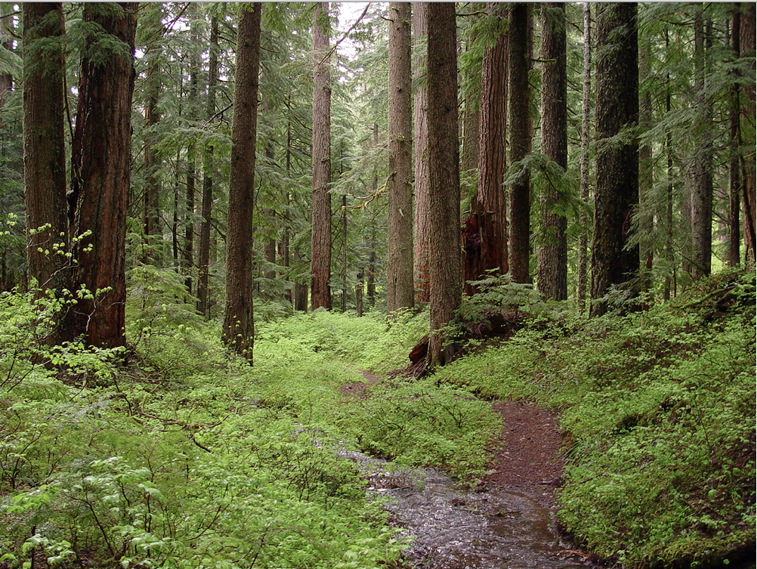
Hypothetical End Game:
“Old Growth” Climax Forest is very rare.

Slide 7
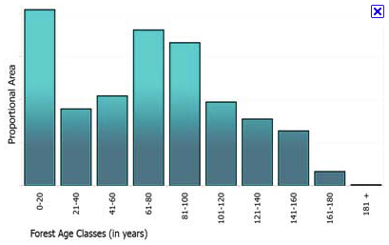
The real story of most forest succession
The average age of slow-growing Boreal Forest stands is quite young.
This partially reflects industrialized forest harvesting
Also reflects the chronic and endemic disturbances affecting forests, especially Boreal Forest.
What disturbance processes are affecting forest succession, resulting in such ‘young’ forest stands?
most forest is <100 years old

Slide 8
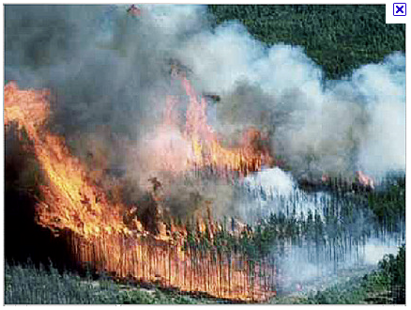
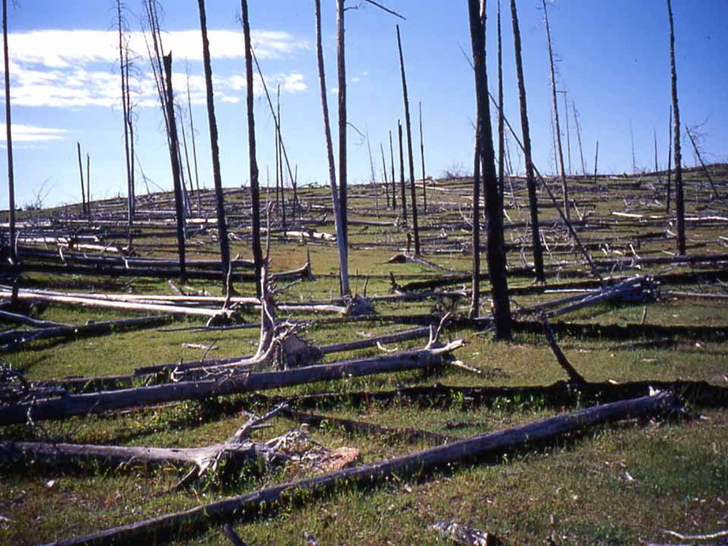
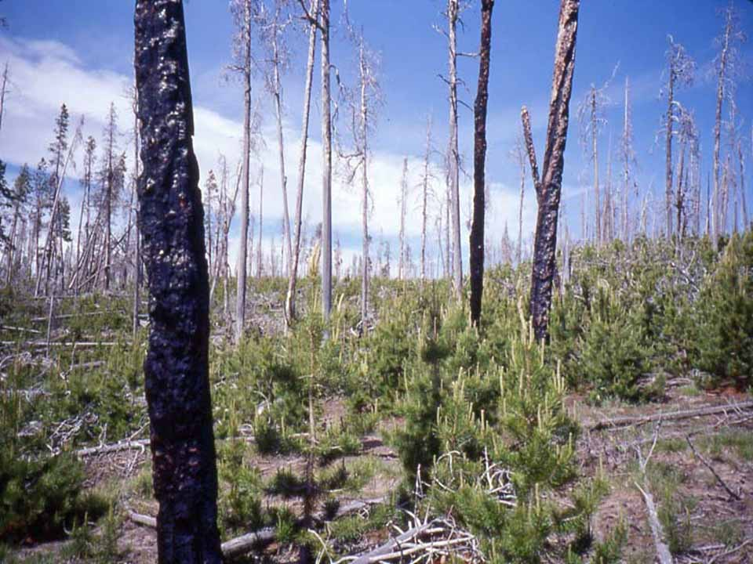
Early regeneration
Forest Fires a natural part of forest succession, & regularly burn large territories, reducing forest to early succession stage.
Regenerating forest areas are often most biologically diverse & useable for humans & other animals.
Did hunter-gatherers use fire to manipulate succession?

Slide 9
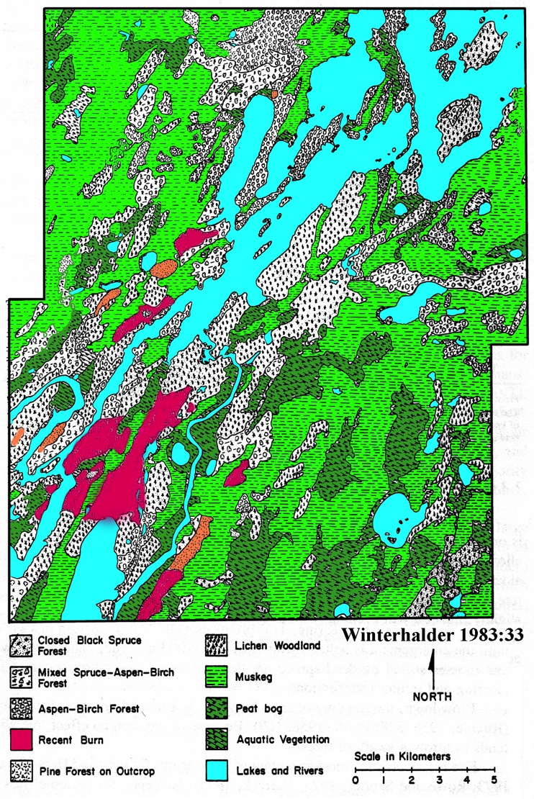
Boreal Forest biotic composition.
Mixed deciduous & coniferous forest. Variation reflects variable soil, moisture & exposure.
Forest in constant biotic flux: chronic disturbance (fire, wind, snow, insect & disease).
Patchy environment: different levels of biotic diversity and productivity.
Most diverse & biologically productive forest patches are recently recovering from disturbance (ie fire).
Foragers maintain knowledge about biological capacity throughout their hunting territory, & use that information to improve odds of foraging success.
Foragers also set fires to enhance habitats in early spring (low intensity burn).
This sample tract demonstrates the extent of wetlands (green, blue), and diverse forest tracts.

Slide 10
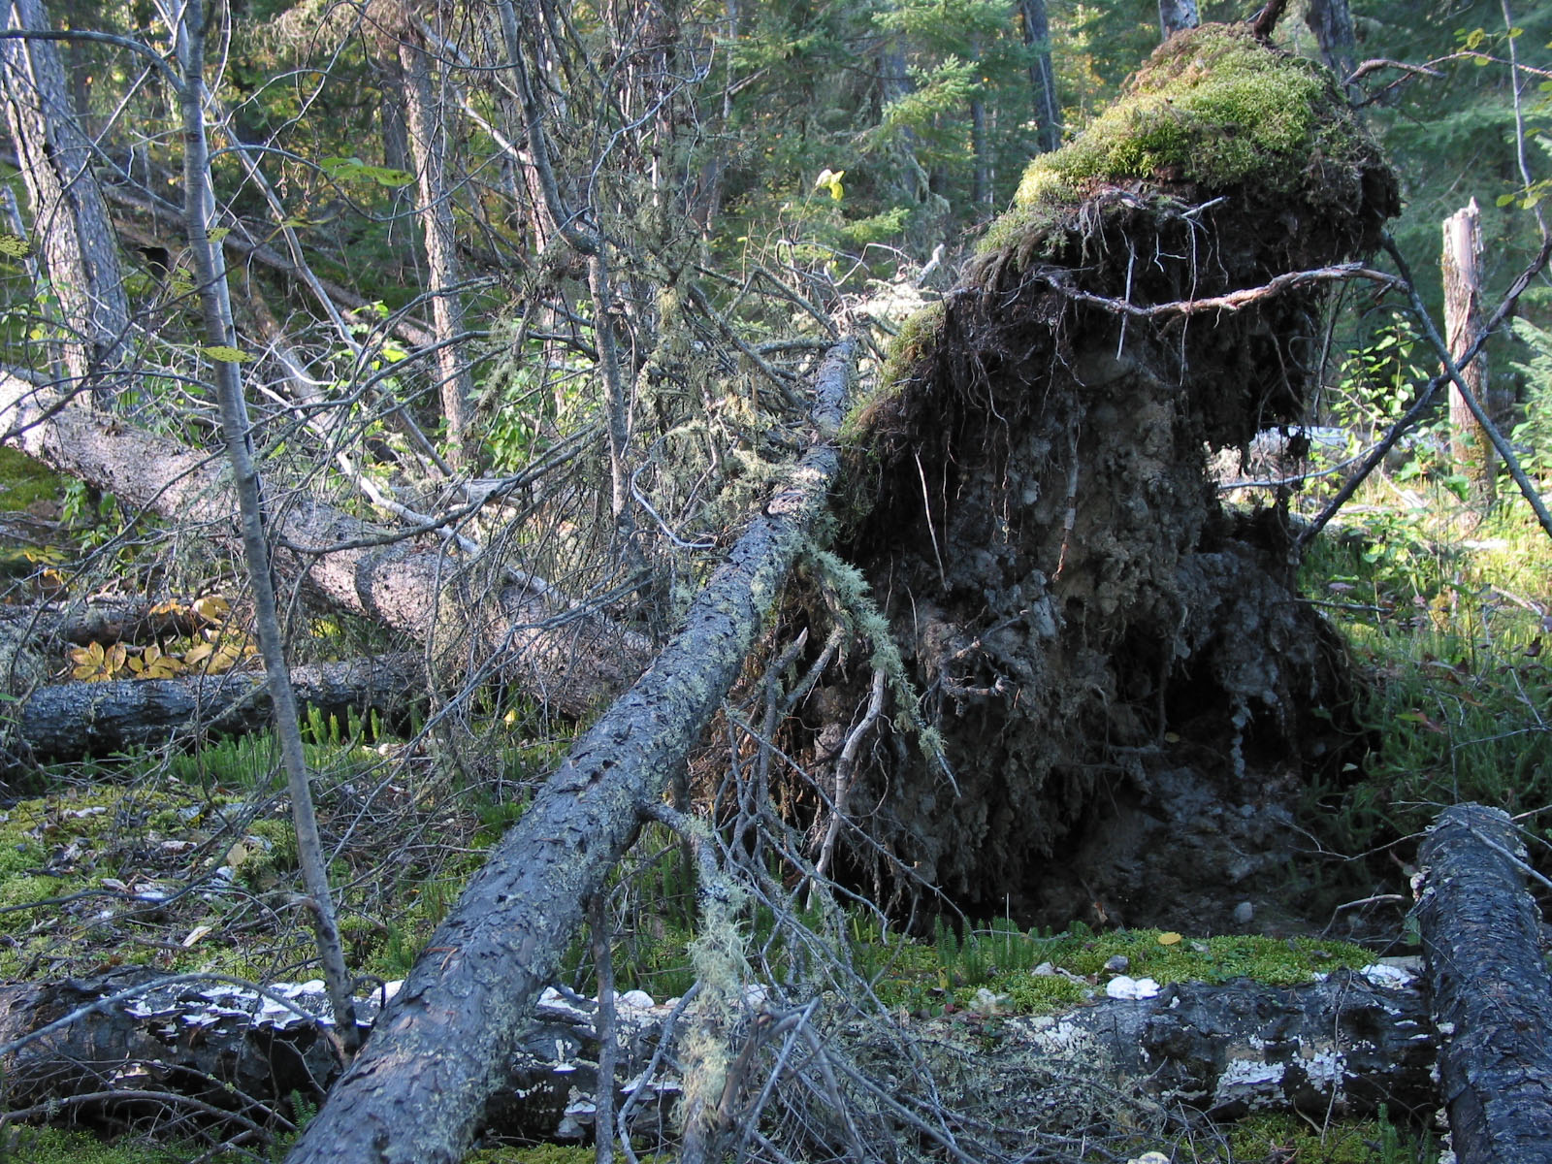
Wind & snow load regularly topple trees, opening up forest canopy.
Favours shade intolerant plants, nutrient recycling, habitat for fungi, insects, birds, small animals.
Bioturbation implications for archaeology?

Slide 11
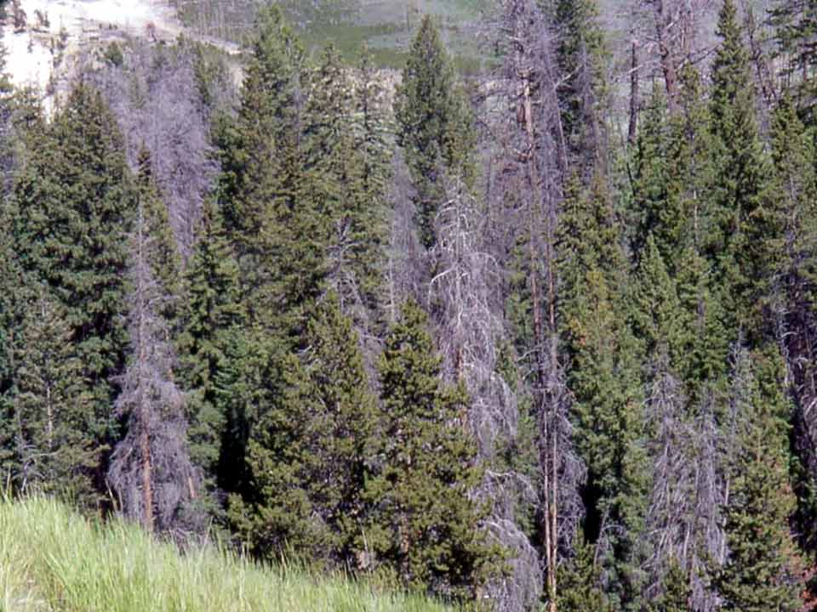
Over-mature forest stands vulnerable to (intense) fire, disease, insects, etc.
Need regular removal of dead wood (chronic low-intensity fires).
Accumulation of dead, dry fuel eventually results in large, extremely hot catastrophic fires.
Intense fires are rare disasters: kill plants and animals, and can consume the organic forest soil.
Forget Smokey

Slide 12
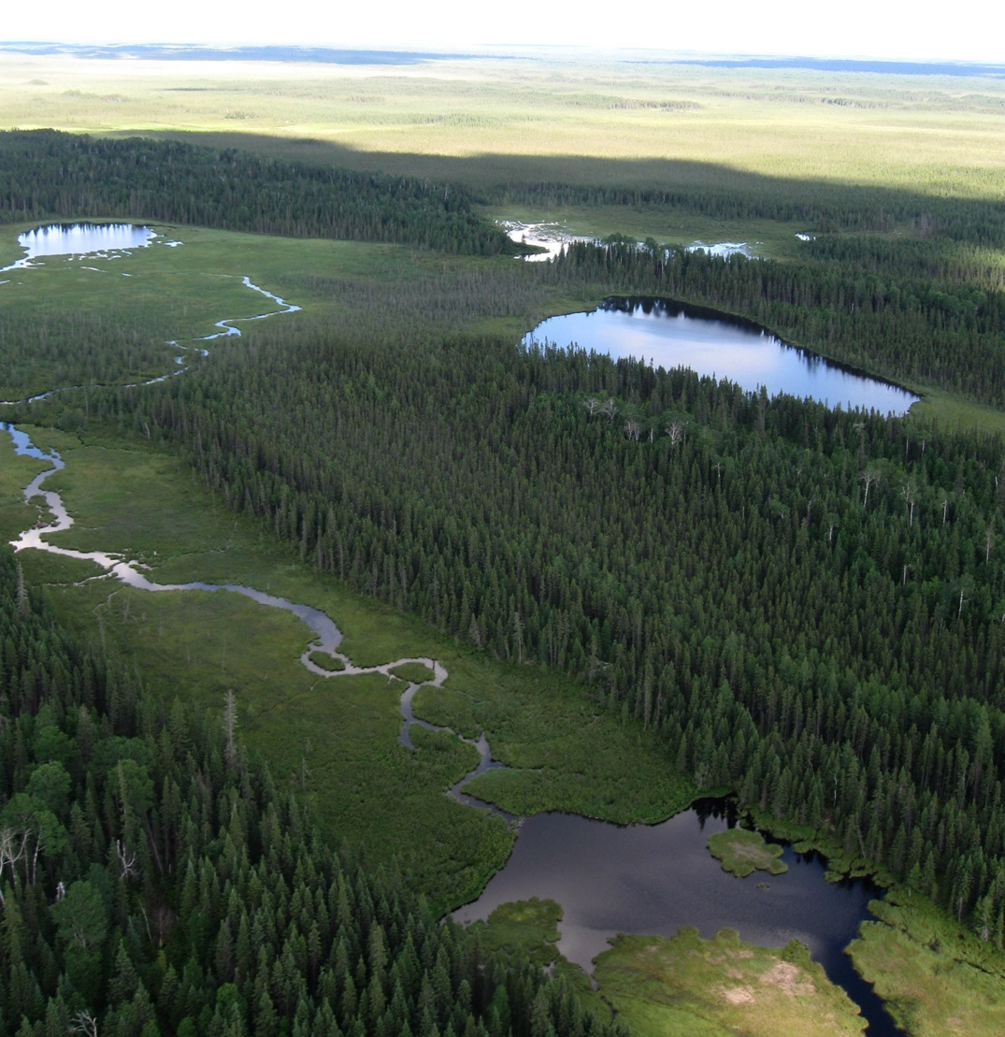
“Climax” Boreal Forest is usually spruce or pine found in places somehow protected from fire.
Perhaps on islands, or in Hudson Bay Lowland where extensive wetlands offer natural ‘fire guards’.
Such forest zones generally have narrow biotic diversity, lower density of plants & animals that humans can utilize.
High trophic level forest has low usable biomass for humans.

Slide 13
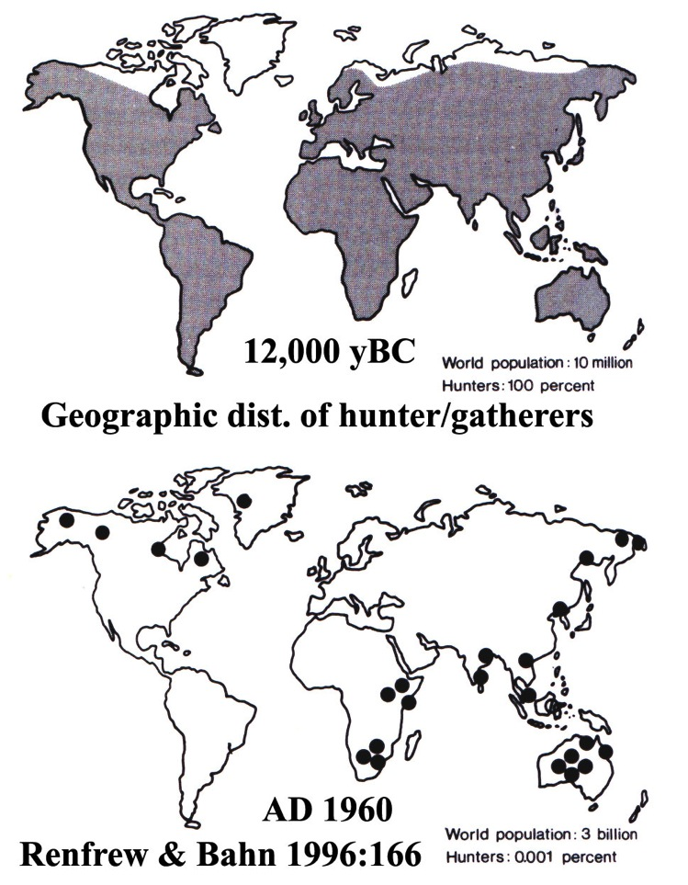
‘Sacred Cow’ Theories & ideas from the foundations of Anthropology
Now discredited notions of 19th C cultural evolutionary theory (savagery➔barbarism➔civilization)
But broad Holocene pattern of change: from foraging, to pastoral/small-scale horticulture, and then sedentary state-level societies... (low-mid latitude origin, with diffusion into temperate areas)...
What about Subarctic and Arctic? Does climate prevent such change, leading to persistence of ‘simpler’ foraging into modern period?
Does recent sharp decline of forager societies reflect general social evolution, or a consequence of European imperialism?
Are there exceptions to these generalizations, and if so, why?

Slide 14
Left: distribution of ethnographically reported pastoral societies. Note exceptional Sami reindeer herders in northern Scandinavia and Russia.
Right: Origins of plant domestication & horticultural societies.
These regions became influential centres for diffusion of new food production systems, settlement patterns and political economies throughout much of the past ca. 5,000 years.

Slide 15
How have general theoretical principles influenced thinking about forager cultures.
What generalizations about forager societies that persisted into the modern period?
General cross-cultural validity?
What is credibility of causal links between observed characteristics?

Slide 16
Two ways of looking at Boreal Forest Foraging adaptation:
1) one approach rooted in modern ecological science, optimal foraging theory, evolutionary ecology.
2) one rooted in Aboriginal spirituality and traditional economy.
Western scholarship is predisposed to think about the first as the best means of analytically ‘measuring’ reality, while the second ‘emic’ orientation reflects culture-bound rationalization of fundamental ecological relationships.
Does this merely reflect a new brand of ethnocentrism? A kind of ‘sciencism’?
Lets think about this as flip sides of the same coin...
How should social scientists approach this?
How does ‘cultural relativism’ fit into this?

Slide 17
1) Human Ecology or ‘optimal foraging’ (Winterhalder): Adaptation to patchy ecology, constant disturbance, and intense seasonality.
diffuse population to harvest seasonally sparse resources (high mobility, efficient transportation, expedient technology, travel knowledge).
cope with seasonality (gather in places & times of resource plenty and predictability, and disperse in times of scarcity)
plan foraging to maximize success (mental inventory of what resources are where, understand processes and details of forest succession, and how to manipulate it through fire ecology)
minimize risk of resource depletion (ensure harvesting does not exceed level needed to replenish... and let land ‘rest’ between harvesting episodes.
build ‘insurance policy’ in case of unpredictable hardship (a wide ranging social network: family, friends and associates in case of hard times, and cultivate an cultural value for hospitality towards those in need).

Slide 18
Foragers are ‘informed’ about their physical world...
It is not random wandering in the bush looking for something to eat...
Foragers keenly aware of their foraging space and its resource potential, its trophic level, and its schedule of recovery from last foraging episode.
Information is shared between foragers in order to plan harvest activities.
Foragers are ‘active’ in management & manipulation of the environment
Fire ecology is an important tool for this (controlled spring burns when bush is damp to get rid of dead or diseased wood, open forest canopy, encourage early spring growth or to encourage berry production, etc).
See readings by H. Lewis… (ecological management by fire)
Manipulate animal behaviour. Moose or goose calling. (Construction of decoys, snares, ambushes or traps along regular travel routes or crossings)
With these principles in place, can we imagine foragers managing resources and resource harvest within known and familiar territories (albeit very large territories).

Slide 19
Successful foraging requires a range of capacities:
physical strength and endurance
technical skills in tool production and use from locally available resources
large scale ecological knowledge about operations and dynamics
geographic knowledge about large territories and how to move efficiently across it.
intellectual ability to hold inventory in memory, to draw upon it at will and to engage in multi-factorial decision making
interpersonal and diplomatic skills for long-term cooperative work with immediate and extended family and also with a much broader network of associates, clan members and others.

Slide 20
2) Aboriginal perspectives on Foraging lifestyle
Physical skills & intellectual abilities important, but also spiritual comprehension of how the world works.
world is animated with spiritual power deriving from the Creator.
Many supernaturally powerful forces exist (rocks, trees, water, wind, animals, etc).
World pulsates with power, & humans are relatively weak. Humans survive primarily because of benevolent interest of spiritual powers.
Worthy humans gain insight and protection from spirits (dreams, visions are communication from an animal spirit guide or protector).
Continued support and interest from the spirits so long as you obey the instructions, observe the taboos, and live a good life.
Animal spirits sacrifice themselves for the well-being of worthy humans.
Humans must recognize the sacrifice, offer thanks, and take no more than is necessary for survival.
Failure to do so will result in animal spirits withdrawing their support and not allowing themselves to be killed in future.

Slide 21
Aboriginal concepts of land ownership (land tenure).
Notion of owning land and resources is very Euro-centric.
Traditional hunter-gather perspective: People cannot ‘own’ land and natural environment the way you can own your shoes.
People have custodial rights and responsibilities to the land.
Through habitual use, some specific families might have rights to specific regions, but not exclusive rights… others who seek permission (establish kin or other ties) might be able to share that land and resources.
Humans do not hold dominion over land, plants and animals (a Judeo-Christian concept).
Rather, people can harvest the land if they are deemed worthy, and have the benevolent interest and support of animal spirits and other-than-human beings who occupy the land.
A fundamentally different philosophical perspective than those either based Judeo-Christian values or in western science.

Slide 22
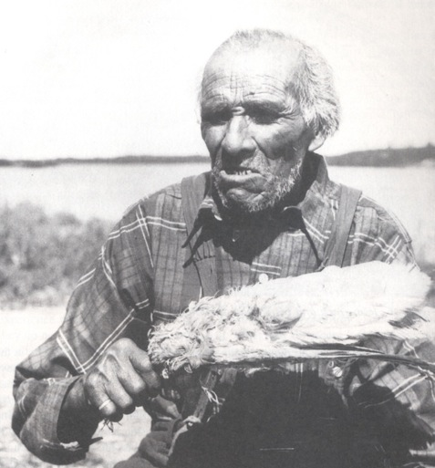
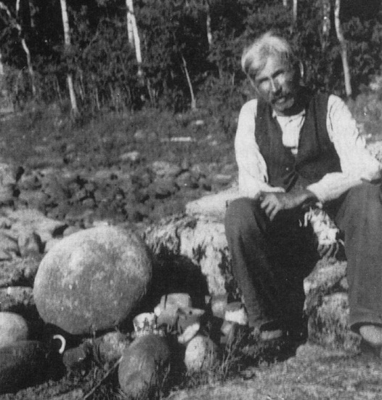
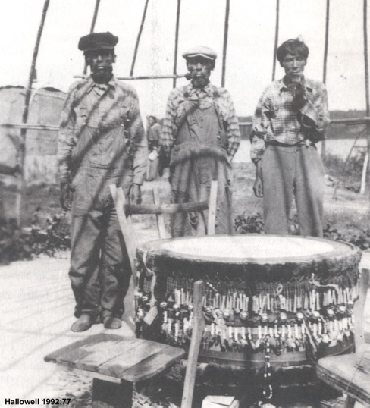
Traditional lifestyles and spirituality persists in contemporary Elders’ memories.
Hallowell 1992
Left: During Hallowell’s 1930s Berens River visits, he met a shaman named Namawin (Fair Wind), grandfather of Elder Whitehead Moose of Pikangikum.
Hallowell 1992
Right: Namawin’s drum communicated with the dead. Some conjuring drums are ritually buried in sacred places in Pikangikum territory.
Contemporary Elders hold information about such places and practices.
Hallowell 1992
Up: Chief William Berens (1930s) sits next to ‘our grandfather’s rock’, said to have sacred power.

Slide 23
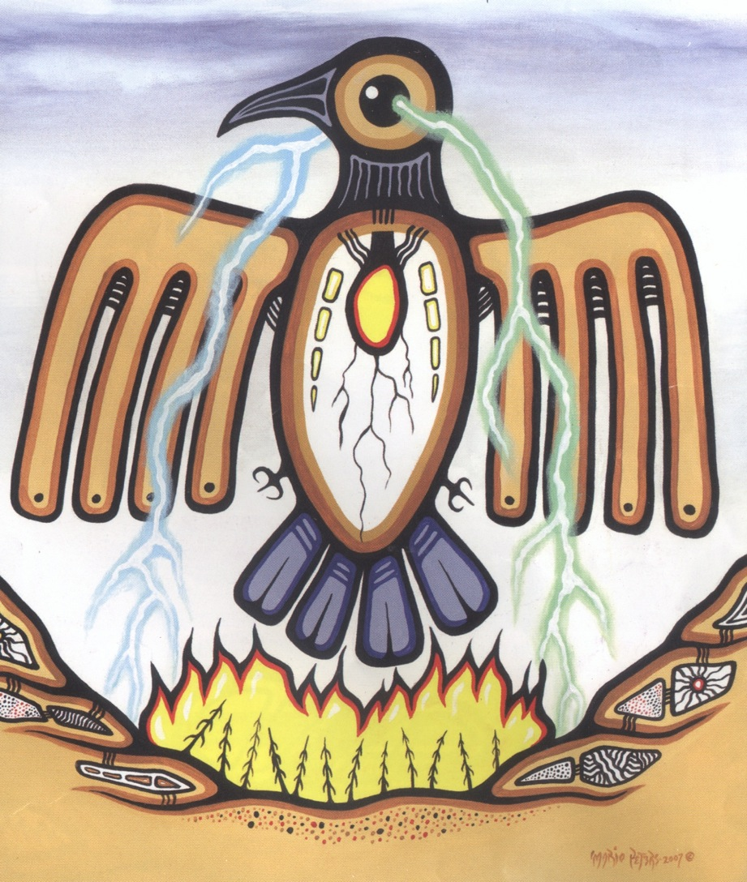
Pikangikum FN artist Mario Peters’ Thunderbird animates Elder Whitehead Moose’s story describing how the Thunderbird’s lightning acts to burn off ‘old food’, to renew the land.
Lightning a symptom of struggle between thunderbirds & giant snakes…
There is an interweaving of traditional knowledge with the operational understanding how the land and the plants and animals (ecology) all interact.
There are many ways of seeing and knowing…
Sagatay Vol 5 issue II, 2009

Slide 24
Two very different ways of seeing the world of Subarctic Foragers.
one based in western ecological science and human ecology (optimal foraging theory, etc)
one based in traditional spiritual value system
Two ways of seeing the same coin?
The traditional forager lifestyle and spirituality has the same ecological effect as a ‘sustained yield’ resource management strategy embedded in ecological principles…
But it is expressed as a sacred relationship and custodial responsibility…
Sacred responsibility is a powerful prevention of short-term strategies of ‘over harvest’...
But how to interpret the fur trade?

