Slide 1

Course Syllabus Statements
& the Academic Integrity Code
Aimee Jaun
Associate Vice-Provost Students
Joel Symonds
Manager, Student Conduct & Case Management

Slide 2

Academic Integrity Code
  SECTION II: RESPONSIBILITIES AND EXPECTATIONS
  FACULTY AND INSTRUCTORS
  Faculty and Instructors have the right to use educational strategies that encourage Students to act with integrity in academic matters. These may include:
    Clearly articulating expectations about appropriate academic behaviour at the beginning of each course;
    Developing course syllabi that clearly set out expectations for referencing sources of information in individual work, for group work, and so on;
    Providing a Syllabus Statement outlining the need to uphold Academic Integrity, an example of which is provided below:
        “A breach of Academic Integrity is a serious offence. The principle of Academic Integrity, particularly of doing one’s own work, documenting properly (including use of quotation marks, appropriate paraphrasing and referencing/citation), collaborating appropriately, and avoiding misrepresentation, is a core principle in university study. Students should view the Student Code of Conduct – Academic Integrity – for a full description of academic offences, procedures when Academic Integrity breaches are suspected and sanctions for breaches of Academic Integrity.”
    Using mechanisms during testing that reduce or eliminate the opportunities for copying, e.g. test facilities, randomized seating, additional invigilators, etc.;
    Regularly producing new tests/examinations, especially for deferred exams or for Students who require alternate exam times; and
    Producing new assignments (e.g. laboratories, essays, report topics) on a regular basis;

Slide 3
Academic Integrity Code
  SECTION II: RESPONSIBILITIES AND EXPECTATIONS
  FACULTY AND INSTRUCTORS
  Faculty and Instructors have the right to use educational strategies that encourage Students to act with integrity in academic matters. These may include:
    Clearly articulating expectations about appropriate academic behaviour at the beginning of each course; (consider AIM/Annual Refresher requirement)
    Developing course syllabi that clearly set out expectations for referencing sources of information in individual work, for group work, and so on;
    Providing a Syllabus Statement outlining the need to uphold Academic Integrity, an example of which is provided below:
        “A breach of Academic Integrity is a serious offence. The principle of Academic Integrity, particularly of doing one’s own work,
        documenting properly (including use of quotation marks, appropriate paraphrasing and referencing/citation), collaborating appropriately,
        and avoiding misrepresentation, is a core principle in university study. Students should view the Student Code of Conduct – Academic
        Integrity – for a full description of academic offences, procedures when Academic Integrity breaches are suspected and sanctions for breaches of Academic Integrity.”
    Using mechanisms during testing that reduce or eliminate the opportunities for copying, e.g. test facilities, randomized seating, additional invigilators, etc.;
    Regularly producing new tests/examinations, especially for deferred exams or for Students who require alternate exam times; and
    Producing new assignments (e.g. laboratories, essays, report topics) on a regular basis;

Slide 4
Academic Integrity Code
  SECTION II: RESPONSIBILITIES AND EXPECATIONS
  FACULTY AND INSTRUCTORS
  Faculty and Instructors have the right to use educational strategies that encourage Students to act with integrity in academic matters. These may include:
    Clearly articulating expectations about appropriate academic behaviour at the beginning of each course;
    Developing course syllabi that clearly set out expectations for referencing sources of information in individual work, for group work, and so on;
    Providing a Syllabus Statement outlining the need to uphold Academic Integrity, an example of which is provided below:
        “A breach of Academic Integrity is a serious offence. The principle of Academic Integrity, particularly of doing one’s own work, documenting properly (including use of quotation marks, appropriate paraphrasing and referencing/citation), collaborating appropriately, and avoiding misrepresentation, is a core principle in university study. Students should view the Student Code of Conduct – Academic Integrity – for a full description of academic offences, procedures when Academic Integrity breaches are suspected and sanctions for breaches of Academic Integrity.”
    Using mechanisms during testing that reduce or eliminate the opportunities for copying, e.g. test facilities, randomized seating, additional invigilators, etc.;
    Regularly producing new tests/examinations, especially for deferred exams or for Students who require alternate exam times; and
    Producing new assignments (e.g. laboratories, essays, report topics) on a regular basis;

Slide 5
Academic Integrity Statements
Course Syllabus Suggestions
  Instructors are welcome to use the example course syllabus statement verbatim, or they can create their own
  If you choose to modify or create your own statement, here are some things to consider:
    Provide a definition of academic integrity and appropriate academic behaviour
    Give specific examples of academic integrity violations (plagiarism, use of unauthorized materials, facilitation etc.)
    Be clear about the serious nature of academic offences
    Explain that all suspected breaches will be investigated using the procedures outlined in the Academic Integrity Code
      Include a direct reference (link) to the Student Code of Conduct – Academic Integrity policy
    Refrain from including any prescriptive statements about sanctions
      Avoid saying things like “student’s caught plagiarizing will get a zero on their assignment”

Slide 6
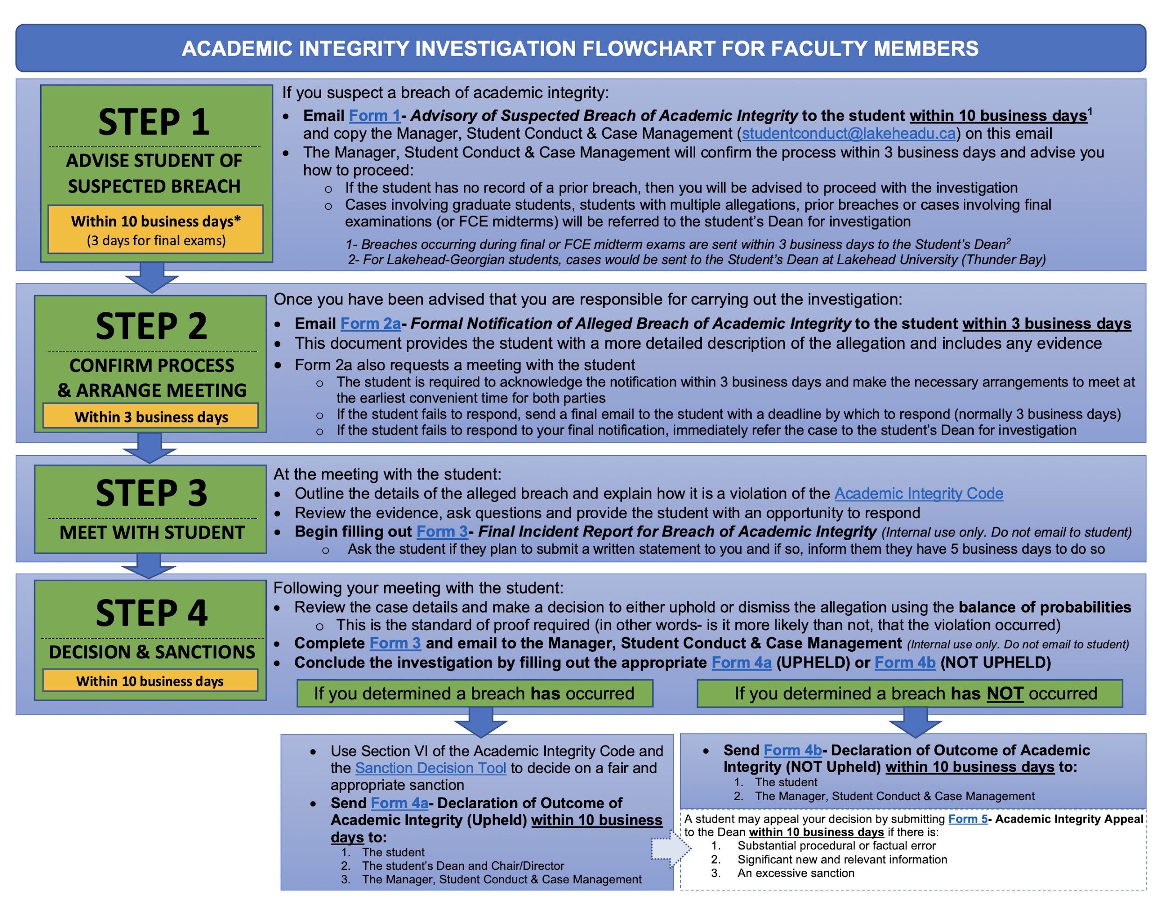

Slide 8
Academic Integrity Code
  SECTION VI: FACTORS TO CONSIDER WHEN ASSIGNING A SANCTION
  The following are factors that ought to be considered when assigning a remedy or sanction for breaches of Academic Integrity, including:
    Evidence of a deliberate attempt to gain advantage;
    Seriousness of the offence having regard to its actual or potential consequences;
    Extent to which the work or conduct in question forms a significant portion of the final grade and whether the extent of the offence is substantial;
    Injury to another Student or to the institution;
    Multiple offences within a single incident or multiple offences discovered at one time, rather than an isolated aberration;
    Whether the offence has been committed by a Student who ought to be familiar with the expectations for Academic Integrity in the discipline, Department and/or Faculty; and
    Conduct that intimidates others or provokes misconduct by others.
  Any Sanction should reflect the extent and severity of the offence, and precedents in the academic unit, taking into account any mitigating circumstances. The onus is on the Student to provide evidence of mitigating circumstances.

Slide 9
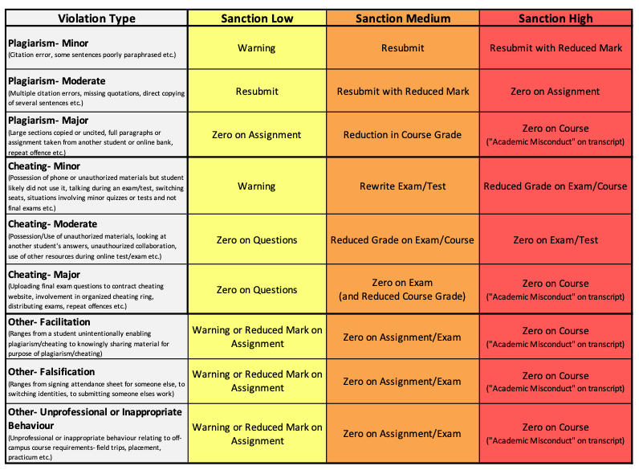

Slide 10
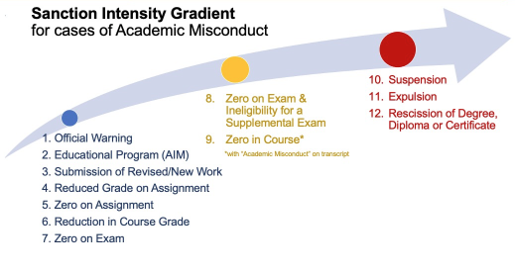

Slide 11
Academic Integrity Code
  SECTION VI: SANCTIONS AND FACTORS TO CONSIDER WHEN ASSIGNING A SANCTION
  The following Sanctions require the approval or recommendation of the Student’s Dean (Note: the possibility of these sanctions should only be discussed with the Student after receiving approval from the Student’s Dean)
    Ineligibility for a supplemental examination or any other evaluative exercise for the course;
    Inability for a student to withdraw from a particular course;
    Mark of zero (F) for the course with a transcript notation of “Academic Dishonesty”;
    Denial of permission to use facilities of the University, including computer facilities, laboratories, etc. for a designated period of time;

Slide 12

  AI-specific statement
  in your course syllabus
  Check out the Teaching Commons webpage
  Teaching and AI

Slide 13
Questions?
Joel Symonds
studentconduct@lakeheadu.ca
807-343-8010 ext. 8163
ATAC 5031A

